Slide 1
USA Car Accidents Severity Prediction
IBM Data Science Professional Certification
Nikita Kohli

Slide 2
Problem
The economic and societal impact of traffic accidents cost U.S. citizens hundreds of billions of dollars every year. And a large part of losses is caused by a small number of serious accidents.
Reducing traffic accidents, especially serious accidents, is nevertheless always an important challenge.
Factors for Accident Severities: Location, Time, Weather, Traffic Signal
Business Problem: Can we try to reduce the severity, thus impact, of the accident? Can we predict the severity with machine learning algorithms?

Slide 3
Data
Data Sources:
This dataset has been collected in real- time, using multiple Traffic APIs.
Attributes:
Traffic Attributes (12)
Address Attributes (9)
Weather Attributes (11)
POI Attributes (13)

Slide 4
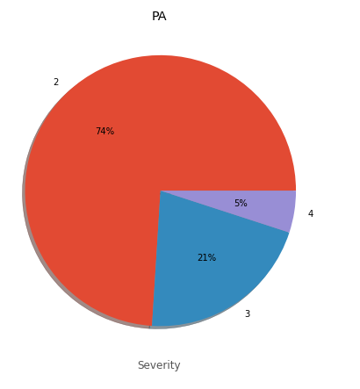
Methodology
Accident severity for the states of Pennsylvania

Slide 5
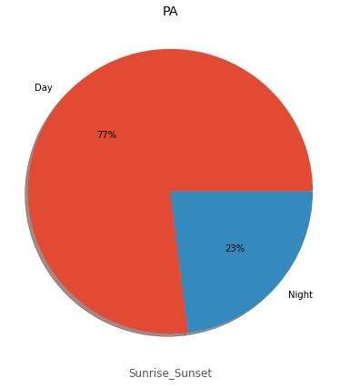
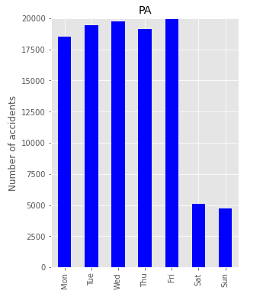
Percentage of accidents during daytime versus night time
Average number of accidents per day for each weekday/weekend

Slide 6
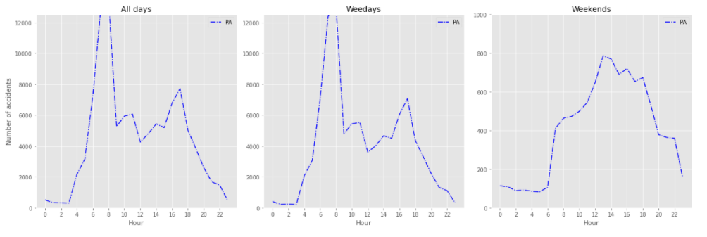
Average number of accidents per severity level per day for each hour on weekday/weekend

Slide 7
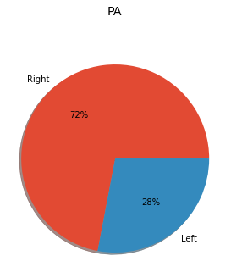
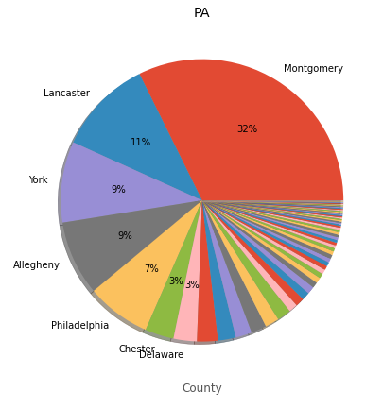
Street sides for accidents
Most dangerous counties

Slide 8
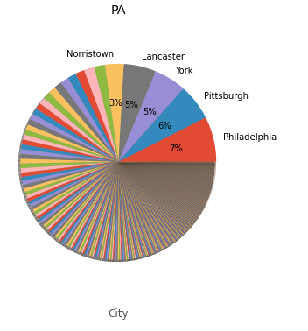
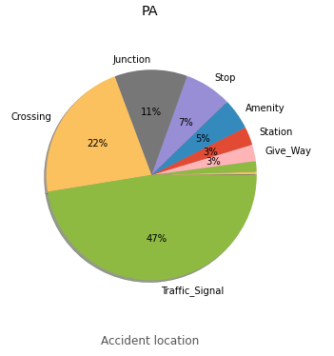
Most dangerous cities
where did most accidents occur

Slide 9
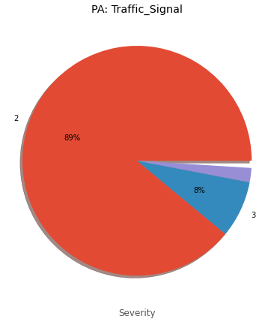
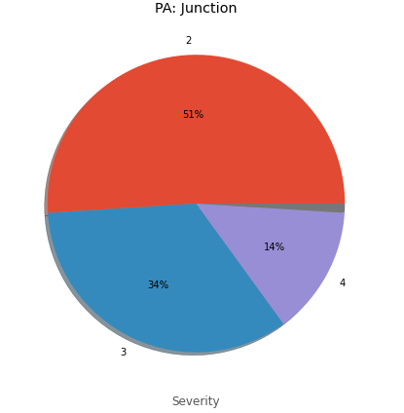
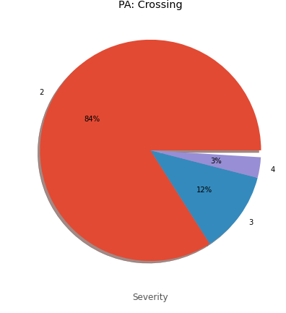
Accident severity levels for each location

Slide 10
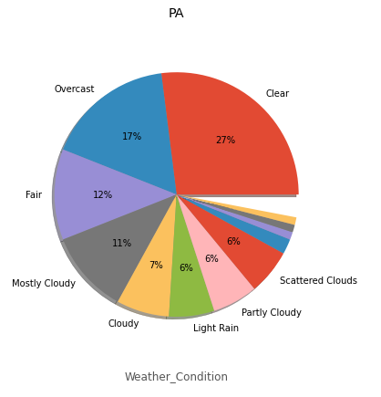
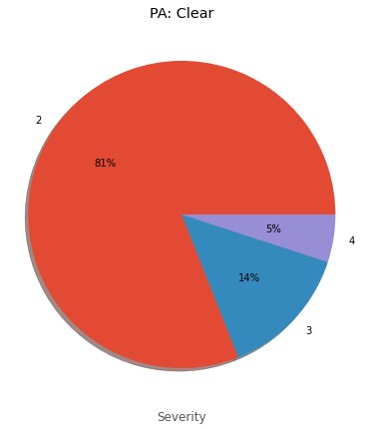
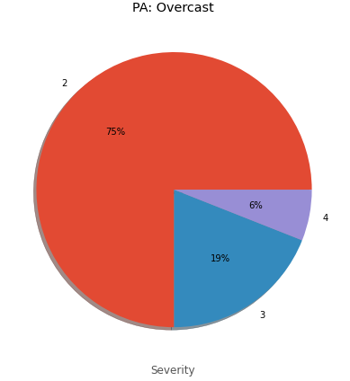
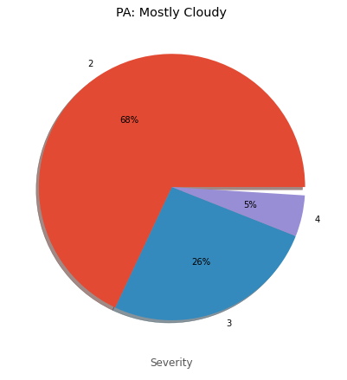
. Percentage of accidents under various weather conditions and accident severity under top three weather conditions

Slide 11
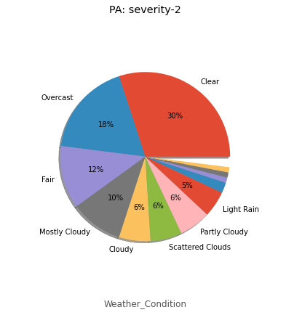
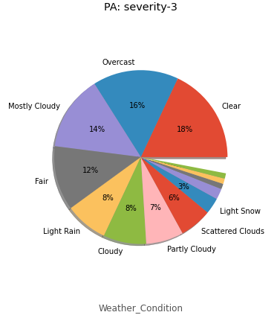
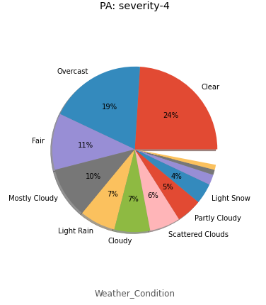
Weather conditions for accidents with each severity

Slide 12
Applying Machine Learning Algorithms to Predict the Severity of Car Accidents
Data Preprocessing
Besides no missing value is allowed, most machine learning algorithms work only with numerical data.
For that, records with missing values were dropped from the calculation. Some outliers, especially with extremely short or long time to clear the accident, were processed and replaced with median values.
As it doesn’t make sense to take 0 minute or many years to clear an accident.

Slide 13
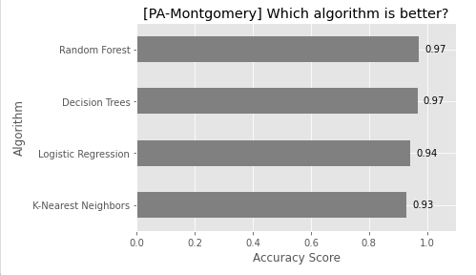
Accuracy of predicting accident severity with various machine learning algorithms for Montgomery county in PA. The accuracy is quite high for Montgomery county in PA.

Slide 14
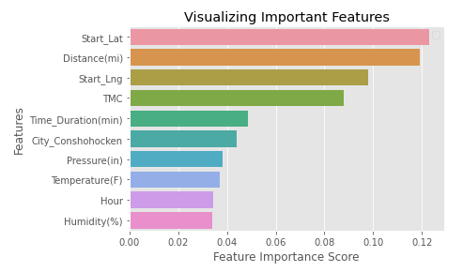
Top 10 features affecting the prediction accuracy for Random Forest algorithm for Montgomery county in PA

Slide 15
Result and Future Work
This study indicates that there are patterns of when, where and under what weather conditions did most accidents occurred. The severity of each accident can be predicted quite accurately with various classification machine learning algorithms.
Incorporate this model in a real-time accident risk prediction model or develop a new real-time severe accident risk prediction on grid cells.
Detailed relations between some key factors and accident severity can be further studied.
Policy implications of this project can be explored.

Slide 16
Conclusion
Country-wide accident severity can be accurately predicted with limited data attributes (location, time, and weather).
Spatial patterns are the most useful features. For small areas like street, severe accidents are more likely to happen at places having more accidents while for larger areas like city, at places having less accident.
An accident is much less likely to be severe if it happens near traffic signal while more likely if near junction.
Weather features like pressure, temperature, humidity, and wind speed are also very important.

Slide 17
Thank you!

